Slide 1
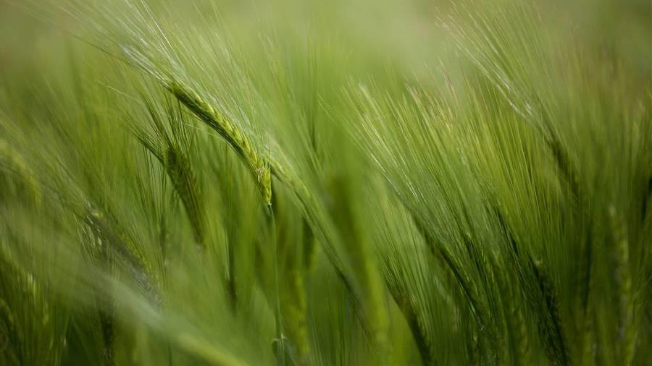
Plant disease detection
Machine learning CS5710

Slide 2
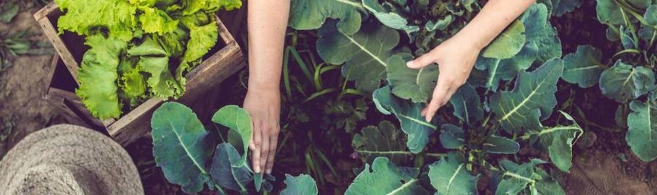
Group members
Shraddha sree Nangunoori
(700739985)
Tejaswini Vempati
(700739779)
Mounika Rayapudi
(700740823)
Sravani Seelam
(700739823)

Slide 3
Role/Responsibilities and Contribution in project
Shraddha sree Nangunoori
Responsible for Data visualization, implementing the KNN and Bayesian SVM algorithm
Tejaswini Vempati
Responsible for Data visualization , implementing the KNN and Bayesian SVM algorithm
Mounika Rayapudi
Responsible for Data gathering & Data pre-processing and Implementing Fuzzy KNN algorithm.
Sravani Seelam
Responsible for Data gathering & Data pre-processing and Implementing Fuzzy KNN algorithm.

Slide 4
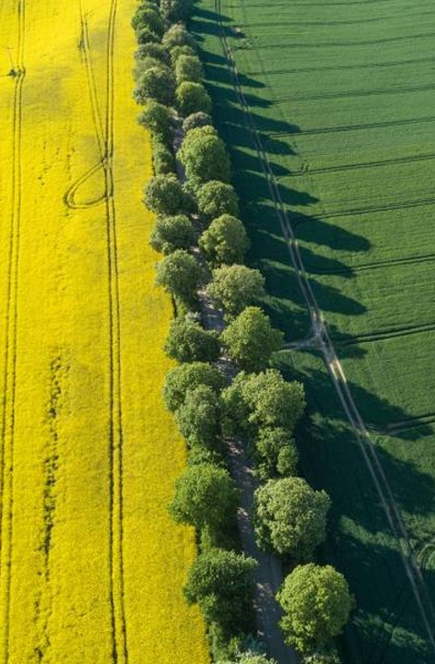
Motivation
The current method used to detect plant diseases is through the naked eye, which is time-consuming, challenging, and inaccurate.
The proposed strategies are put into practice where gadgets are employed for the automatic identification of diseases that make the procedure cheaper and easier. This increases the accuracy rate and makes it more helpful
Here, in the proposed project we have used a few of the machine learning algorithms to categorize and identify the plant disease.

Slide 5
objective
Our main goal is to identify and categorize plant diseases by analyzing the leaf image data provided using the KNN, Fuzzy-KNN, and Bayesian SVM classification methods.
Our model should be able to identify the differences between healthy and diseased plants with the highest possible accuracy.

Slide 6
Related work
The pre-processing or purification of data is a crucial stage in the job of a machine learning engineer, and the great majority of them invested a lot of time and effort before creating a model from scratch. Data pre-processing methods include removing unwanted or noisy data, treating missing values, and detecting outliers. Identification of plant pathogens is an important subject that has been explored throughout the years and is driven by the need to create nutritious food. Expense, consumer, sensitivity, and accuracy are some desired factors to consider, nevertheless. Several works have suggested several non - destructive methods to get around those facts over the past ten years. Methods for multispectral local sensing were employed to assess how stressed plants were by their surroundings.
Some of the most well-known manual feature extraction techniques, which are typically paired with classifiers include Support Vector Machines (SVM).
Due to machine learning's (ML) exceptional performance as a feature extractor in picture identification tasks, the concept has been applied to a variety of fields, including robotics, agriculture, and automation.

Slide 7
Problem statement
The current method that farmers employ to find plant diseases allows them to be seen with the unaided eye and by applying their knowledge of plant ailments. The process of doing so on a large number of plants is time-consuming, challenging, and inaccurate. The expense of consulting specialists is high.
Many initiatives have really been created to stop crop loss from diseases. Over the past ten years, integrated pest control has increasingly been used to supplement traditional ways of pesticide administration. Whatever the method, the first phase of ineffective illness management is accurate disease identification when it first manifests.
In addition, Farmers with less expertise may use drugs throughout the identification process without thinking about the repercussions of their conduct and render incorrect conclusions.

Slide 8
Proposed solution
The dataset was split into three categories, with training datasets and testing datasets being separated by 80% and 20%, respectively, to prevent overfitting. Purification of data is a crucial stage in the job of a machine learning engineer.
To get more accurate findings, some background noise should be eliminated before feature extraction. After the image has been transformed from RGB to grayscale, it is smoothed using a Gaussian filter.
Specifically, in this project, we are selecting features based on the correlation between various variables and the target variable.
The goal of this study is to categorize plant illnesses using KNN, Fuzzy-KNN, and Bayesian SVM Machine Learning classification methods to analyze leaf image data.
The execution plan is as follows.
Data Gathering
Data cleansing
Building the model
Implementation
Comparing the models
​
Plant disease detection

Slide 9
Proposed solution
In order to distinguish between healthy and diseased leaves from the generated data sets, we proposed the below algorithms for classification.
Fuzzy KNN: Based on how closely the previously encountered examples resemble the training data, it classifies them. But when it comes to categorization, it gives every labeled sample the same weight. It is possible to increase precision in many ways, with the Fuzzy k-Nearest Neighbors (FuzzykNN) classifier being one of the most effective. You may determine the fuzzy degree of membership of each instance to the problem's classes using FuzzykNN.

Slide 10
Proposed solution
Bayesian SVM: This "Support Vector Machine" algorithm is a supervised machine learning algorithm that can be used to address classification and regression issues. Because it is a Bayesian model, the regression parameters also get a prior distribution that is multivariate normal. This model uses the widely accepted assumption that the residuals are normal.
​
KNN :
The k Nearest Neighbors (kNN) approach uses a database in which the data points are divided into numerous unique classes to predict the categorization of a new sample point. By choosing the k data points that are closest to the new observation and choosing the class with the highest frequency among them, the approach identifies which points from the training set are sufficiently similar to be taken into account when choosing the class to forecast for a new observation. Consequently, it is called the k Nearest Neighbors algorithm.

Slide 11
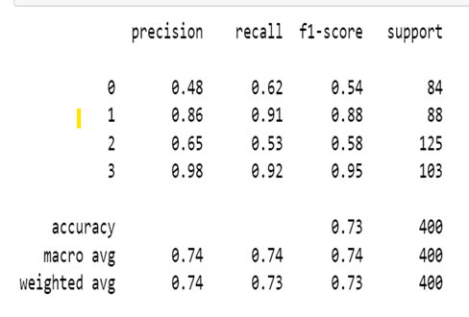
Results
The accuracy of the Bayesian SVM is 73%.
Accuracy score:0.7325
Output: Classification report for Bayesian SVM

Slide 12
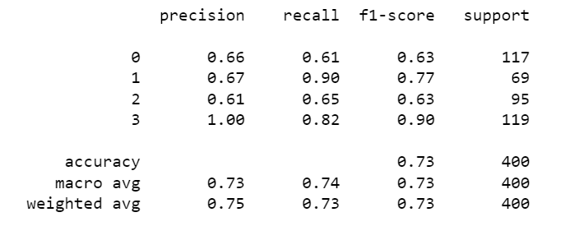
Results
The accuracy of the KNN is 73%.
Accuracy score:0.73
Output: Classification report for KNN

Slide 13
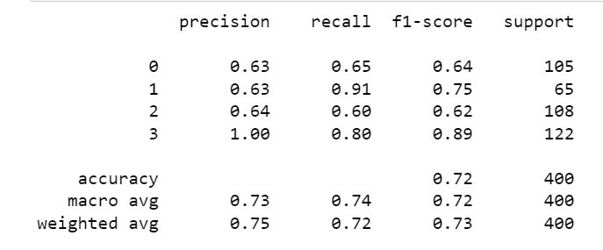
Results
The accuracy of the Fuzzy KNN is 72.2%.
Accuracy score:0.7225
Output: Classification report for Fuzzy KNN

Slide 14
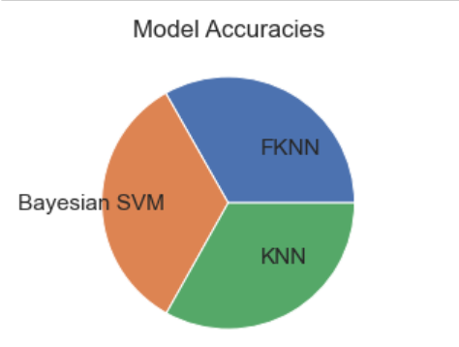
Result comparison
Comparing the accuracy of the models of the corn data set
On average, the accuracy for all three algorithms performed is 73%.
Pie chart comparison

Slide 15
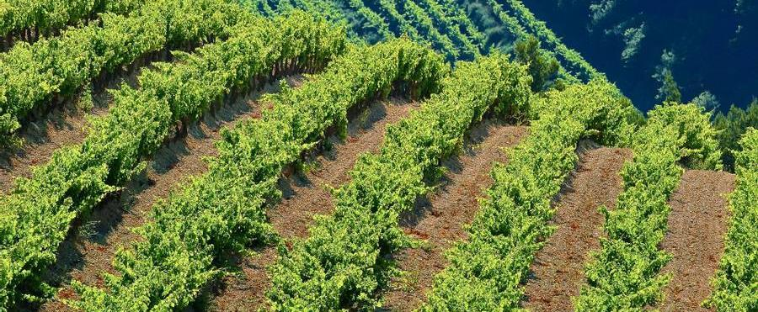
references
Too, E.C.; Yujian, L.; Njuki, S.; Yingchun, L. A comparative study of fine-tuning deep learning models for plant disease identification. Comput. Electron. Agric. 2019, 161, 272–279.
Chen, J.; Liu, Q.; Gao, L. Visual Tea Leaf Disease Recognition Using a Convolutional Neural Network Model. Symmetry 2019, 11, 343.
Oppenheim, D.; Shani, G.; Erlich, O.; Tsror, L. Using Deep Learning for Image-Based Potato Tuber Disease Detection. Phytopathology 2019, 109, 1083–1087.

Slide 16
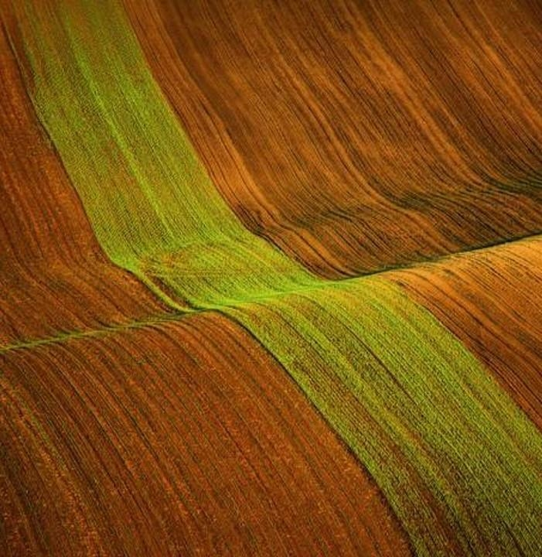
Thank you

